Slide 1
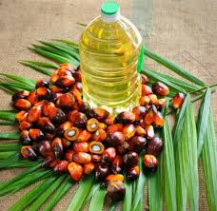

Palming off the Earth
Wanda Wang
Apr. 26th 2016

Slide 2

Introduction

Slide 3

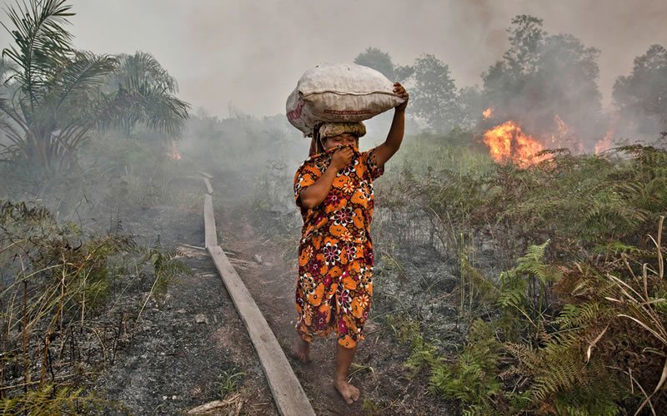

Stakeholders

Slide 4
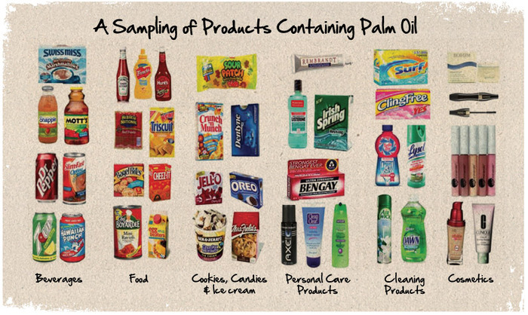
“Green Gold”

Slide 5
The Datasets
UN Food and Agriculture - provides information on global Palm oil production and area harvested
Global Forest Watch -Palm oil Mill location data and fire alert data available for our review

Slide 6
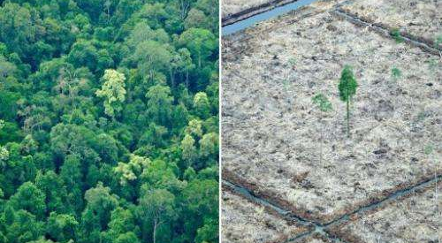
Exploratory Questions
Which countries are the top producers of Palm oil?
Where are the palm oil mills located within these countries?

Slide 7
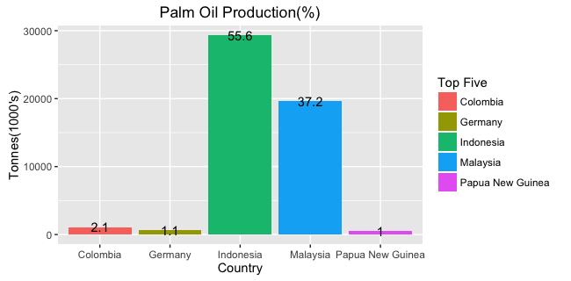
Production: Top Five

Slide 8
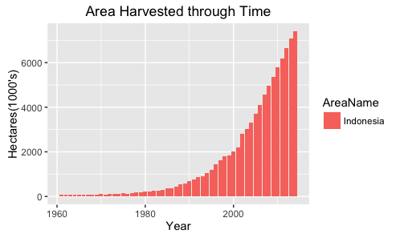

Slide 9
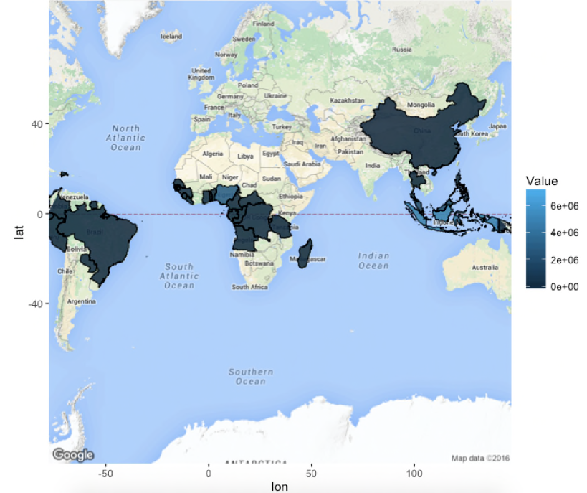
Global Production(Area)

Slide 10
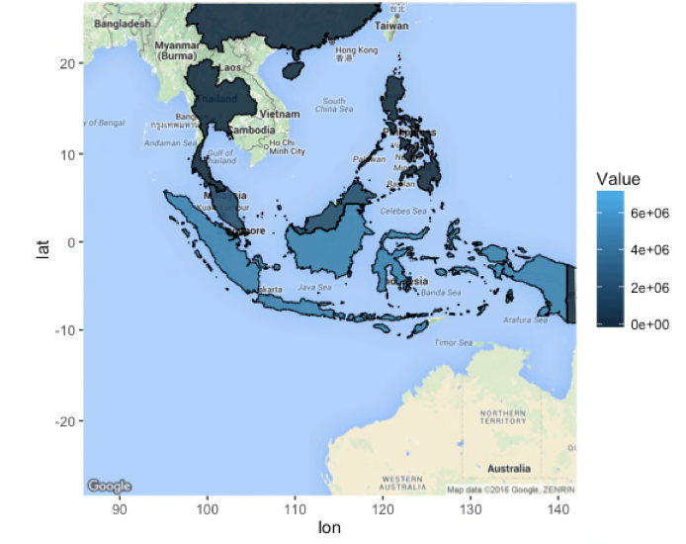
Production in Asia(Area)

Slide 11
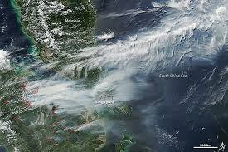
Satellite View

Slide 12
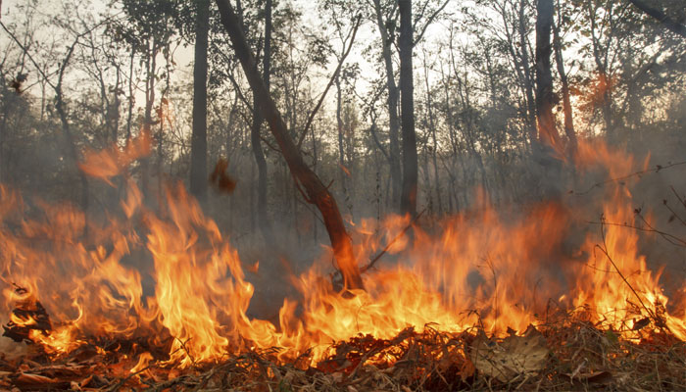
Forest Fires

Slide 13
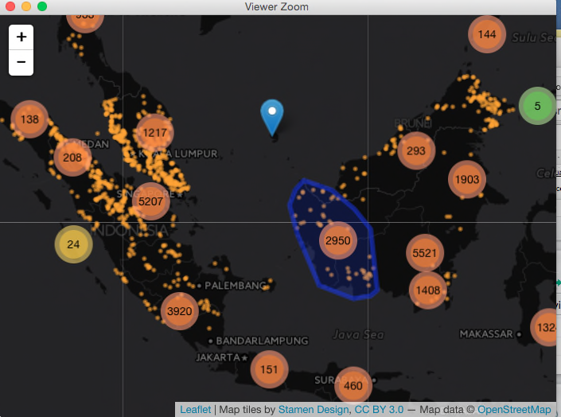
Mill Distribution & Fire Hotspots
go to Class Github html page

Slide 14
Conclusion
Indonesia possesses the most Palm Oil Mills as currently reported in available data
Is there a trend between species extinction and habitat location in Palm Oil producing nations?
There is a strong presence of fire hotspots within the last year where the majority of Mills are located
How much has the Air Quality Index been impacted?
Are there any geographic overlaps with existing nature reservations- what is the tree cover loss over time in those areas?

